Slide 1



Replication: The Importance of Breaking Even: How Local and Aggregate Returns Make Politically Feasible Policies
Gerber, A.S., Huber, G.A., Tucker, P.D., Cho, J.J., 2023.
Replication by Vismante Dringelyte

Slide 2
Introduction of study
Question: How do policy outcomes impact voter support?
This study looks at how voters’ evaluation of candidates, projects and vote choice are affected by outcomes of policies that bring different levels of benefits both on a local district level and an aggregate city level.
The study is carried out through an experiment which assesses this, as well as a replication experiment which adds the element of challenger candidates bringing attention to the outcomes of candidates’ policies.

Slide 3
Why?
Legislators must balance providing benefits to both local constituents and the general public.
In turn voters must trade-off local benefits to aggregate ones.
This research is important in understanding the priorities of voters and facilitate the introduction of more feasible policies.

Slide 4

Hypothesis
The authors provide the hypothesis that incumbents that support aggregate benefits will experience a discontinuous increase in support around the local break-even threshold, as voters move from being opposed to losses to minimising gains when they see net-zero returns.

Slide 5
Assumptions
Independence of observations.
Homoscedasticity: the variance of residuals in constant across all levels of independent variables.
Normally distributed residuals.
Variables
Independent variable: city and district returns.
Dependent variables: incumbent evaluations, vote choice, and project evaluations.
Model
The authors use linear regression to analyse the data.

Slide 6
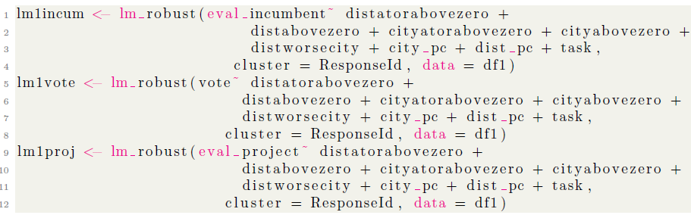
Model

Slide 7
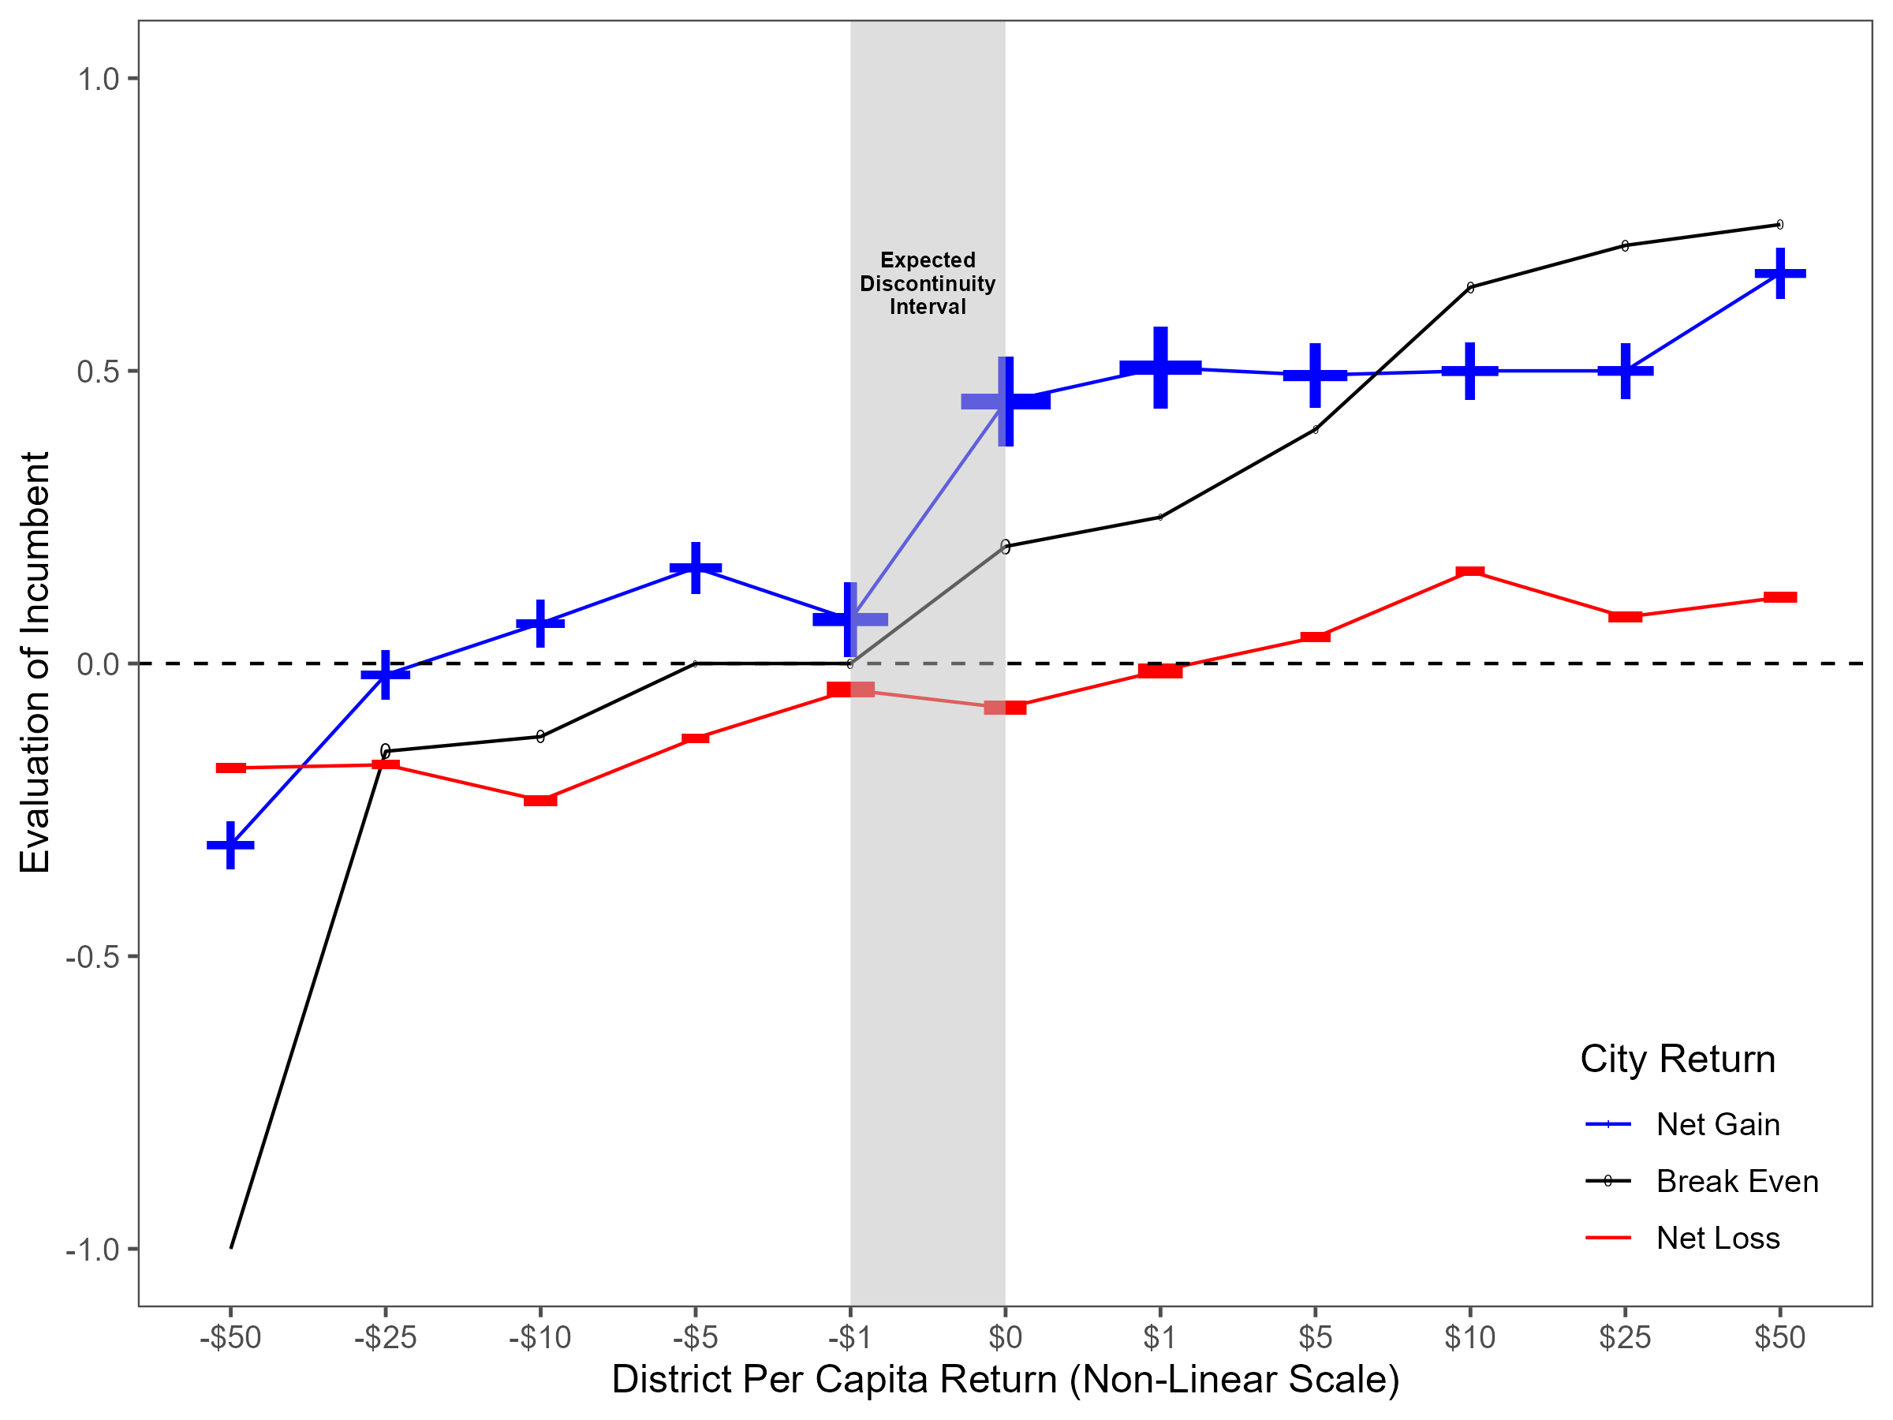
Results
The figure shows the mean incumbent evaluations by district per capita returns, categorised
by net city returns. It shows a break in linearity around the breaking even point for
district returns.

Slide 8
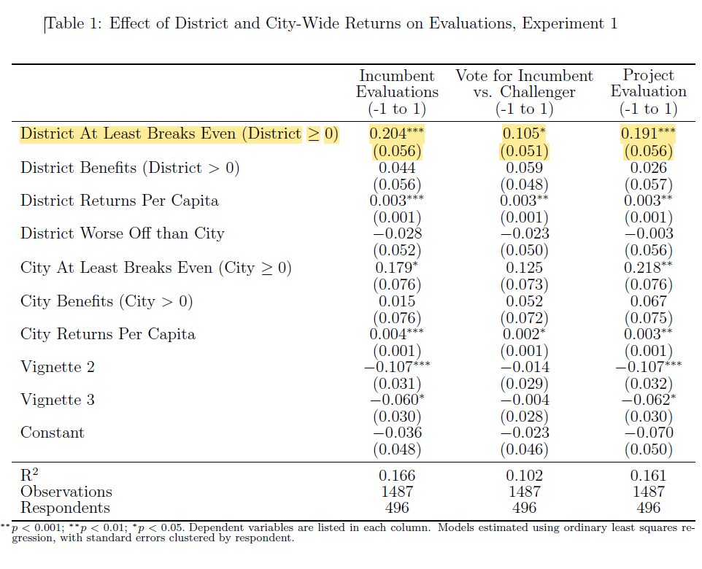
Results
This table shows the effects of local and citywide returns on evaluations. The results around the breaking even point confirm what was shown in the graphic visualisation.
The district at least breaking even is expected to improve the evaluation of the incumbent, willingness to vote for the incumbent and the evaluation of the project.
These results are also statistically significant at p < 0.001.

Slide 9
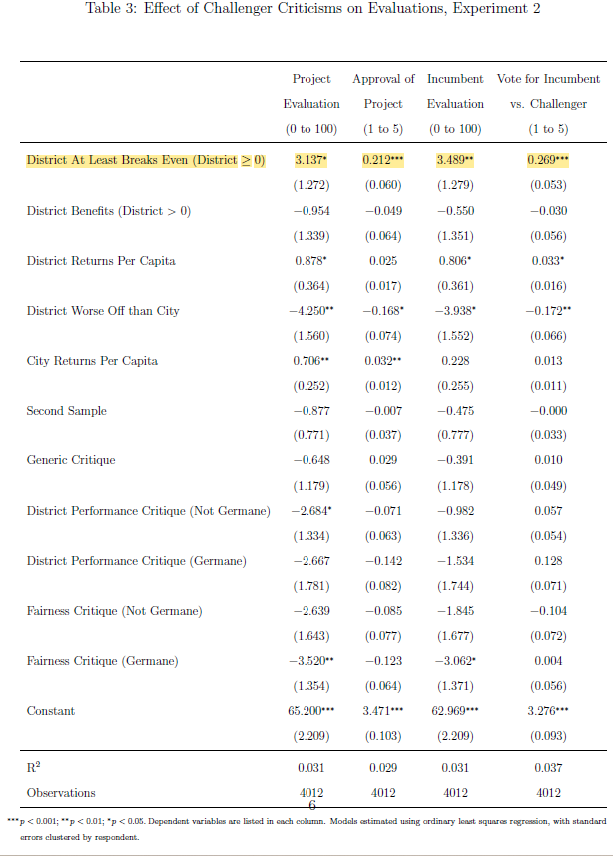
Results of replication experiment
This Table shows the results from the second experiment where challenger criticisms were also presented to the respondents.
This showed similar results to the previous experiment.

Slide 10
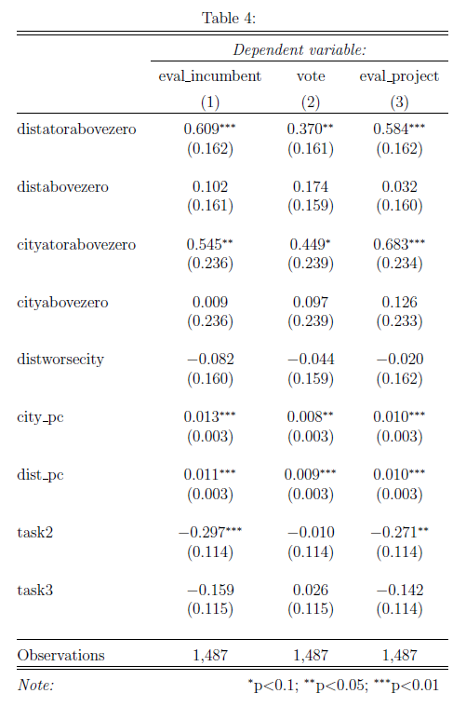
Twist
I decided to run an Ordinal Logistic Regression to see if it gave different results
As we can see, the OLR provides similar results. This shows that the model is quite robust.

